Slide 1


Basic E-Voting System
NBKR INSTITUTE OF SCIENCE AND TECHNOLOGY
GUIDED BY: ASHOK SELVA SIR
DEPARTMENT: Computer Science Engineering
SEC: E
YEAR : I Year II Sem
TEAM MEMBERS:
S.YASASWINI(24KB1A05KB)
U.PALLAVI(24KB1A05LW)
T.LAHARI(24KB1A05KU)
TANUSHREE(24KB1A05KQ)

Slide 2

Overview
Introduction
Objective
Why c and DSA (Data Structures and Algorithms)
Algorithm
Lesson learnt
Code
Output

Slide 3

Introduction
Voting is an essential part of democracy. Traditionally, voting is done manually, which is time-consuming and prone to human errors .
This project aims to build a Basic E-Voting System using the C programming language and Data Structures to make the voting process simple, fast, and secure (one person, one vote).

Slide 4

Register candidates for an election . Allow users (voters) to cast a vote only once . Prevent multiple voting by the same voter . Count the votes for each candidate . Declare the candidate with the highest votes as the winner . Understand how basic Data Structures and modular programming can solve real-world problems.
Objective
This Photo by Unknown Author is licensed under CC BY

Slide 5
WHY C LANGUAGE& DSA?
C Language is fast, close to hardware, and helps understand the memory and logic behind a system.
Data Structures (Arrays, Structs) allow organized storage and management of information (Candidates, Voters).
Algorithms provide a systematic method to solve the problem efficiently.
Using C and DSA together gives better control over how data is processed, saved, and retrieved, making the system reliable and efficient

Slide 6
Algorithm
Step 1: Initialize the Voting System - Set candidate count and voter count to 0.
Step 2: Register Candidates - Input candidate names. Assign each candidate a unique ID.
Step 3: Voter Voting - Input voter ID. Check if voter has already voted using the voter list. If not voted: Display candidates. Record the vote for the selected candidate. Add the voter ID to prevent multiple votes.
Step 4: Counting Votes - Display the vote count for each candidate.
Step 5: Declaring Winner - Find the candidate with the maximum votes. Display the winner's name and total votes.
Step 6: Exit the system.

Slide 7
Code
https://onlinegdb.com/2tqz-7IjN

Slide 8
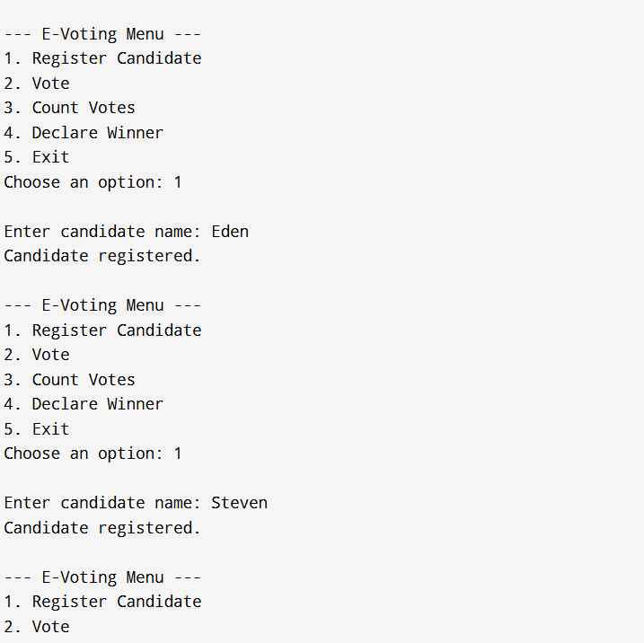
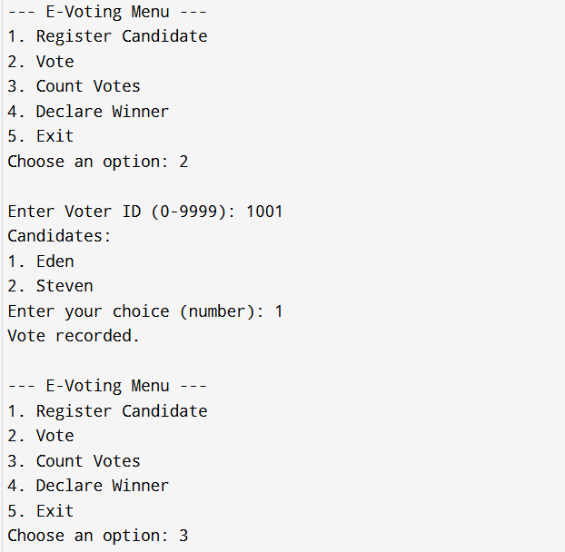
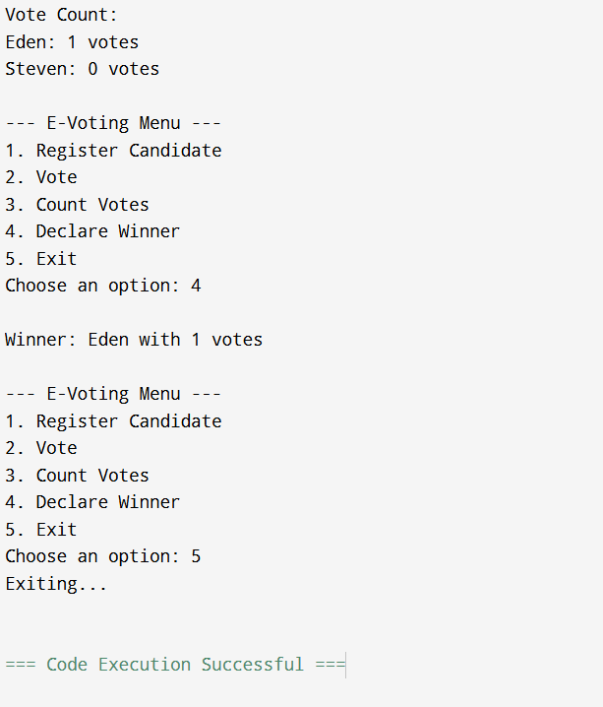
Output

Slide 9
PROS AND CONS
Advantages
dISADVANTAGE
1. Simple and User-Friendly
2. Prevention of Double Voting
3. Fast Vote Counting
4. No Internet Dependency
5. Efficient Candidate Management
6. Lightweight and Fast Execution
1. Hard Limits on Candidates and Voters
2. No Persistence (Volatile Storage)
3. Voter Authentication is Weak
4. Single Vote Round (No Multi-round Voting)
5. No Tie Handling in Winner Declaration
6. No Security Mechanisms
7. Limited Usability Features

Slide 10
LESSON LEARNT
Learnt Practical use of Structures and Arrays to store data.
How to build a simple real-world application using C.
Importance of validation (like preventing double voting).
Using modular programming (functions) to make the code clean and understandable.
Basics of searching and counting algorithms

Slide 11

Summary
This project shows how basic concepts of C programming, structures, arrays, and simple algorithms can be combined to build a working E-Voting System.

Slide 12
Thank You

